Slide 1



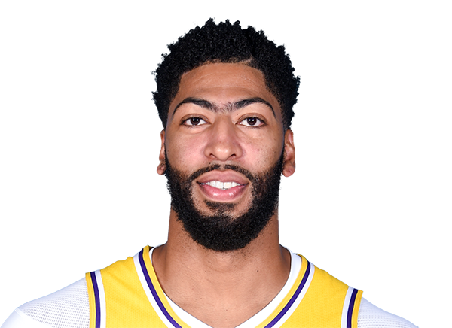
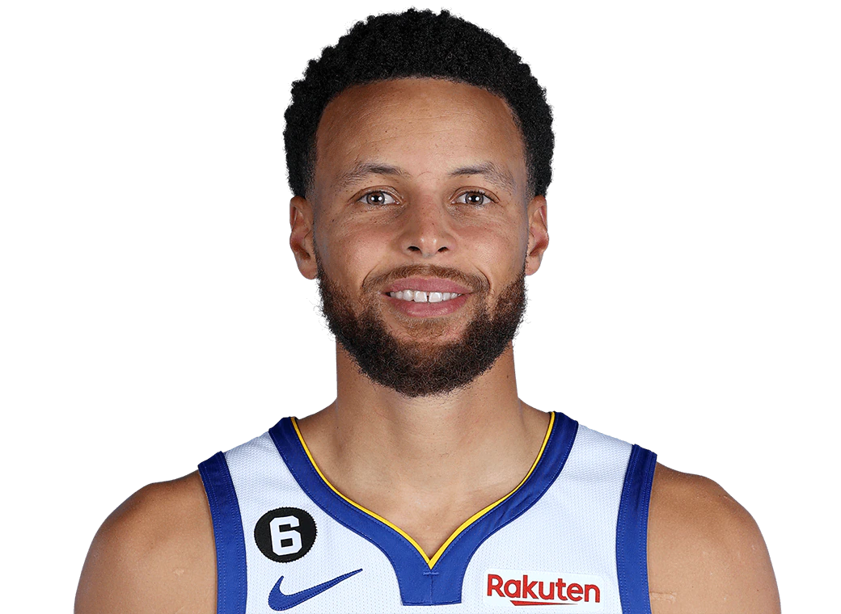

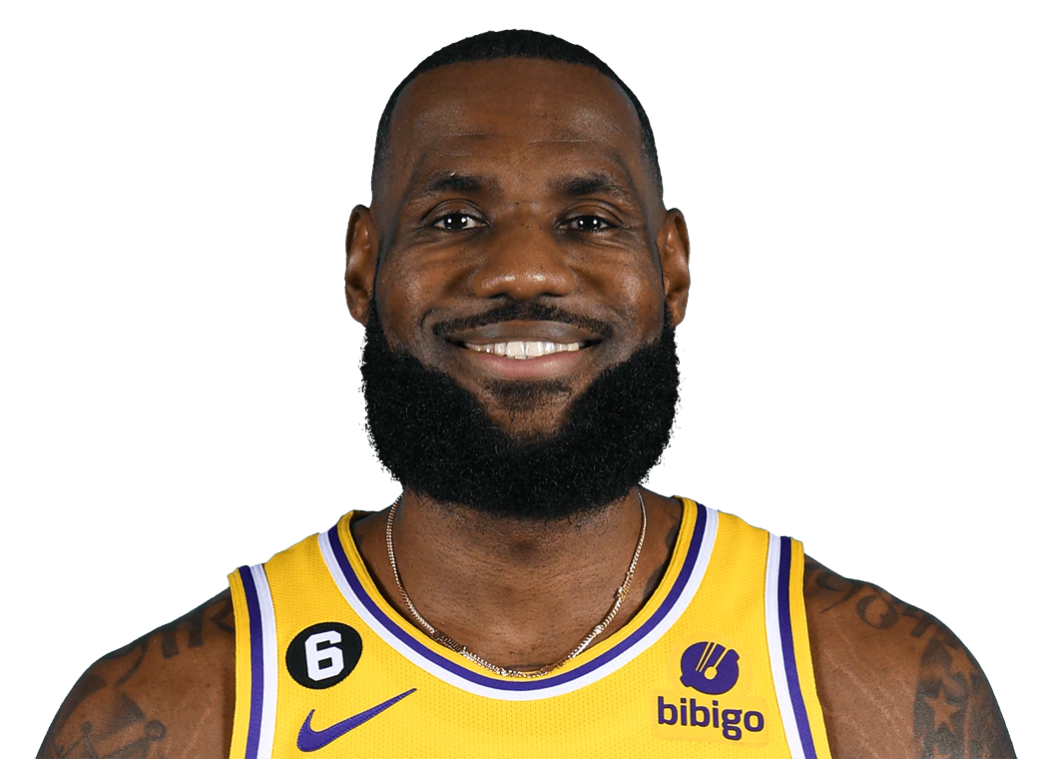
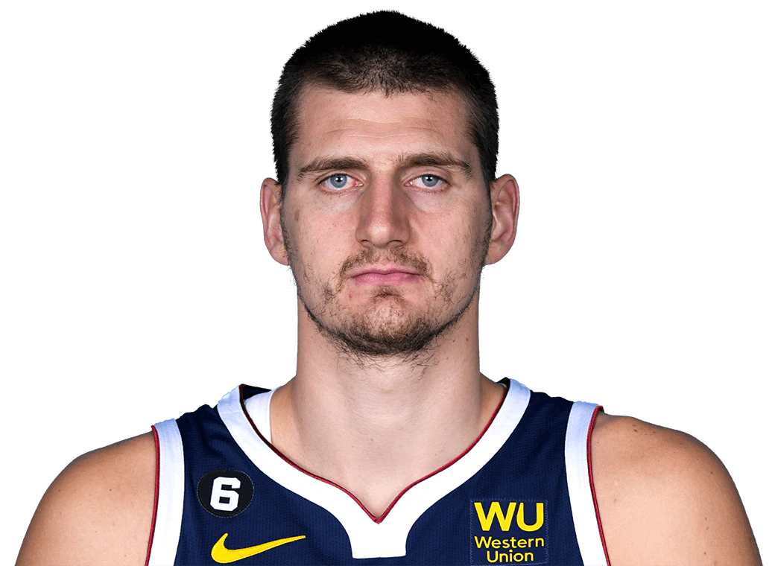






2023 NBA Western Conference All-Star Predictions
By: Eric Drew
As of Dec 15, ‘22
Player (Guard/Frontcourt): All-Star Probability
1
Luka Doncic (G): 99.9%
Anthony Davis (F): 99.9%
2
3
Steph Curry (G): 99.98%
Shai Gilgeous-Alexander (G): 99.7%
4
LeBron James (F): 99.2%
Nikola Jokić (F): 99.0%
5
6
Ja Morant (G): 98.8%
Devin Booker (G): 96.3%
7
8
Damian Lillard (G): 88.2%
Damontas Sabonis (F): 77.2%
9
10
Zion Williamson (F): 69.2%
Lauri Markkanen (F): 8.5%
11
12

Slide 2

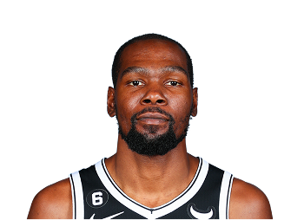
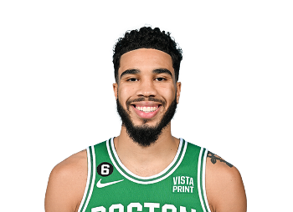
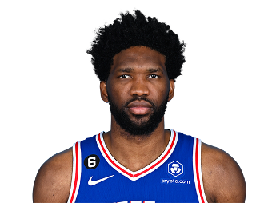



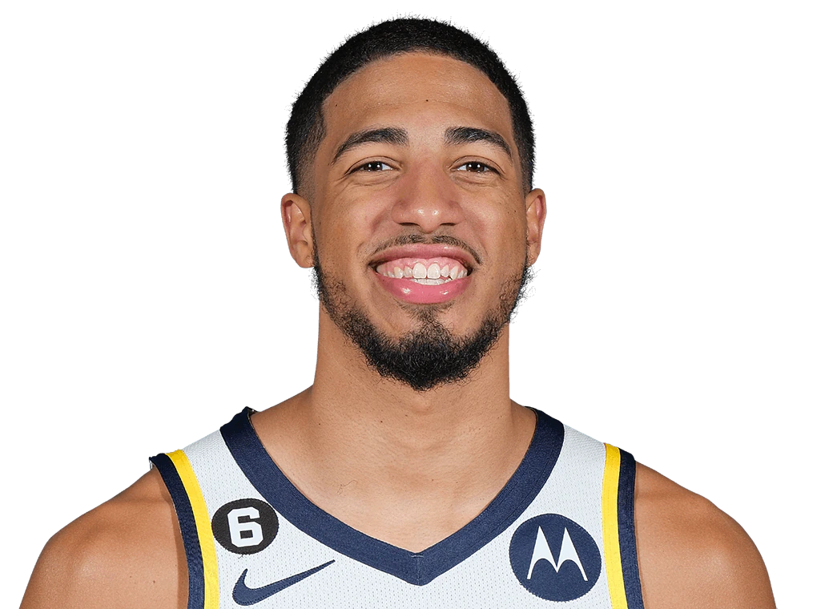

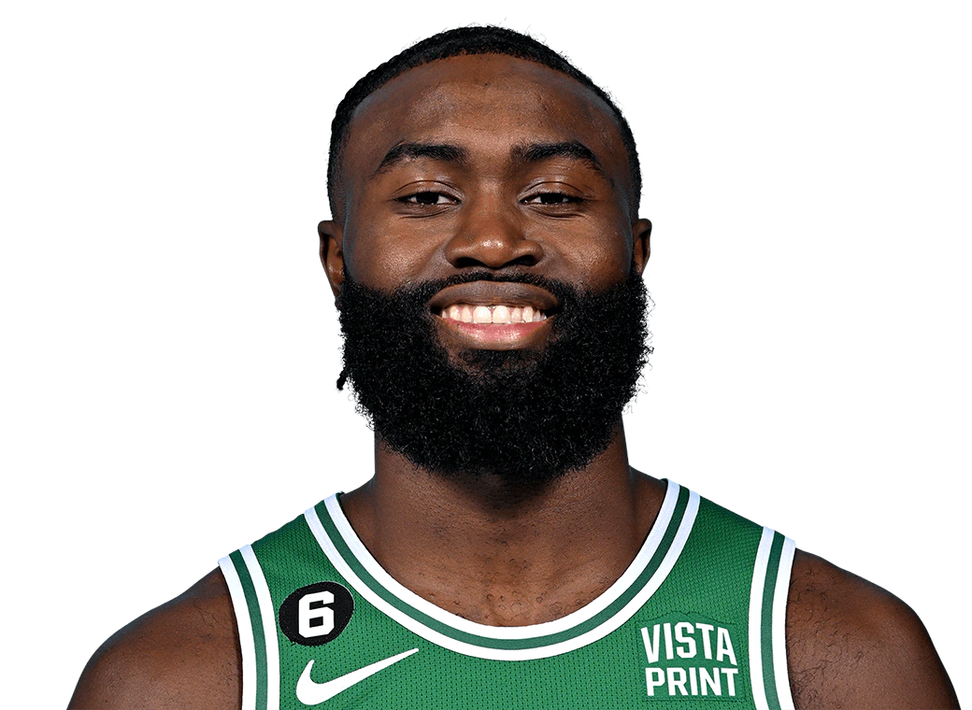
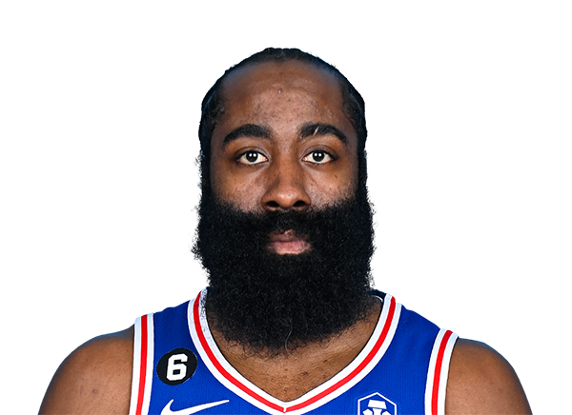

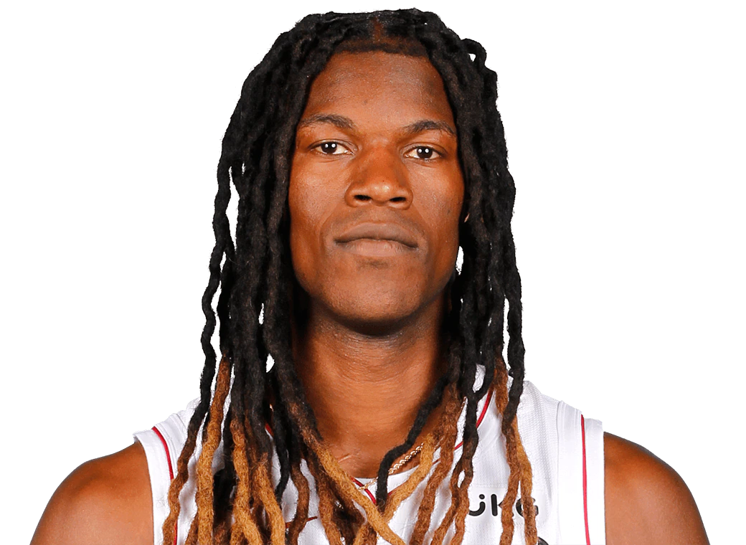
2023 NBA Eastern Conference All-Star Predictions
By: Eric Drew
As of Dec 15, ‘22
Player (Guard/Frontcourt): All-Star Probability
1
Kevin Durant (F): 99.9%
Jayson Tatum (F): 99.9%
2
3
Joel Embiid (F): 99.98%
Giannis Antetokounmpo (F): 99.7%
4
5
Kristaps Porzingis (F): 98.9%
Donovan Mitchell (G): 96.4%
6
Tyrese Haliburton (G): 93.2%
DeMar DeRozan (F): 93.1%
7
8
9
Jaylen Brown (F): 92.3%
James Harden (G): 82.9%
10
11
Trae Young (G): 77.8%
Jimmy Butler (F): 17.0%
12

